Slide 1
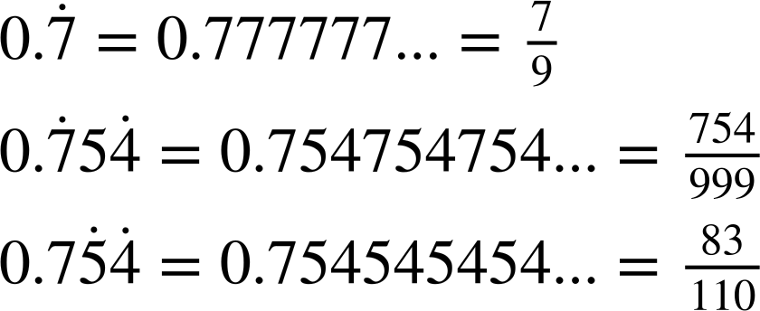
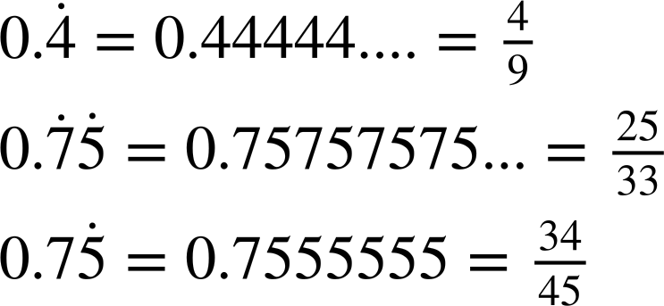
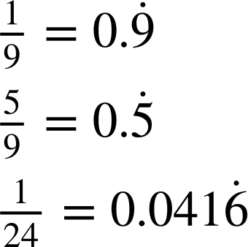
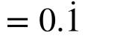
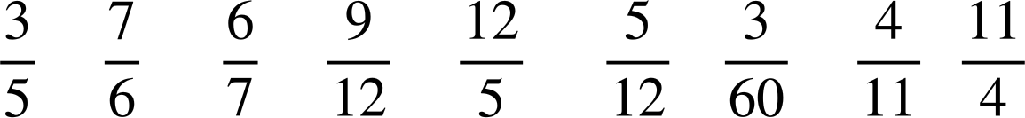
Converting fractions to recurring decimals
Task A: Recognising recurring decimals
1) Match the correctly notated recurring decimal with the decimal form.
…
2) Using short division, identify the recurring decimal of the following fractions:
a)
b)
c)
3) Circle the fractions which are equivalent to a recurring decimal.

Slide 2
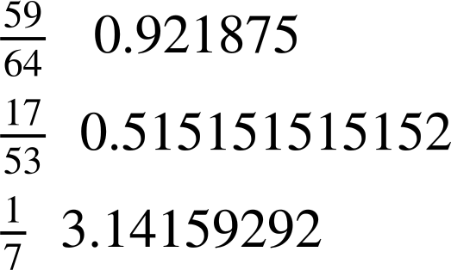
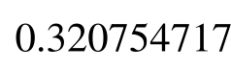
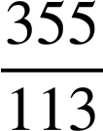

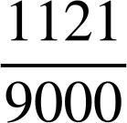

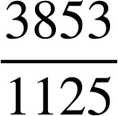

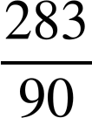
Converting fractions to recurring decimals
Task B: Using a calculator
1) Using a calculator, match the fraction to the equivalent decimal to the correct statement.
Terminating decimal
Non-terminating decimal
2) Match the correctly notated recurring decimal with the decimal form.
3) Write the following recurring decimals as a fraction.
a)
b)
c)
Mathematics in Education and Industry
v2.2

